Slide 1




MALLA REDDY
TECHNICAL CAMPUS
A Constituent Unit of
MALLA REDDY VISHWAVIDYAPEETH
(Deemed to be University)
Maisammaguda, Medchal (Dist), Hyderabad, Telangana
PRESENTRED BY:
TEAM 19 -
Food Donation Marketplace
K.V.S AKSHITH--25MVCSMR0232(L)
T. PRANAV TEJA--25MVCSMR0269
M. SANJAY--25MVCSMR0246
D. GOPI--25MVCSMR0210
EDUCATION INNOVATION EXCELLENCE SERVICE TO SOCIETY

Slide 2



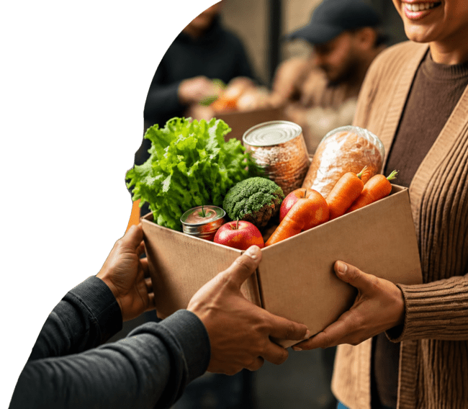






Food
Bridge
Food Donation Marketplace
Connecting surplus food with people who need it most.
foodbridge-six-jet.vercel.app

Slide 3





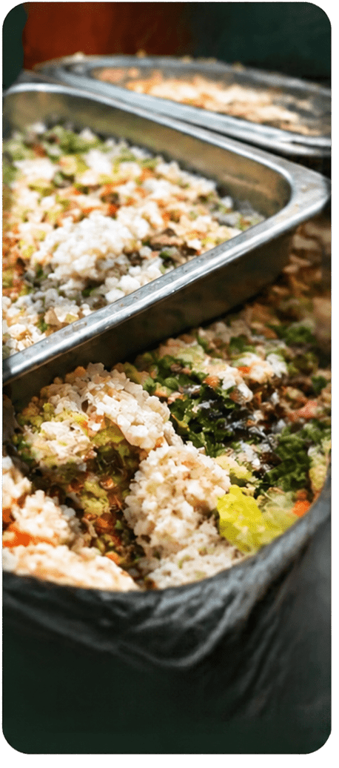
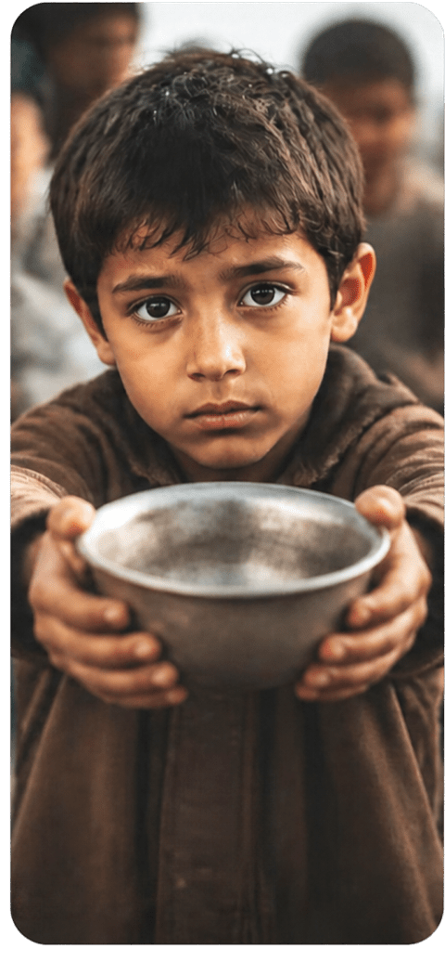















Food waste and hunger
coexist.
Safe surplus food is often available
Too many people face food insecurity
Donors and recipients are not connected
Without a simple platform, food goes to waste

Slide 4

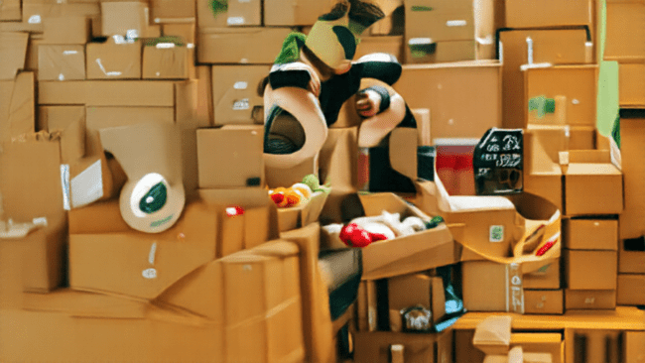

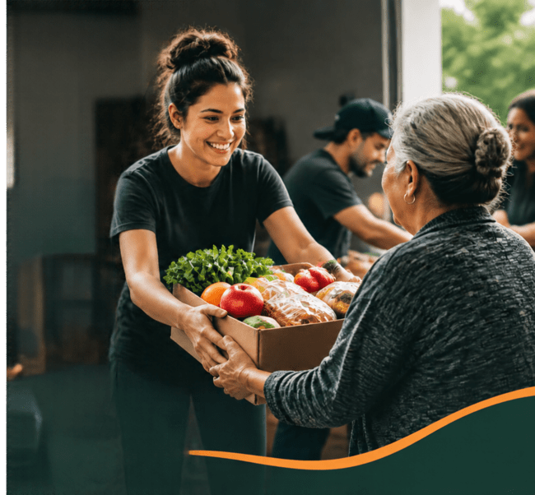












Make food sharing
easy, accessible, and impactful.
MISSION
Bridging the gap between surplus food providers and people or organizations in need.
Reducing food waste while
supporting communities.
VISION
A world where edible food is not wasted
when someone nearby needs it.

Slide 5


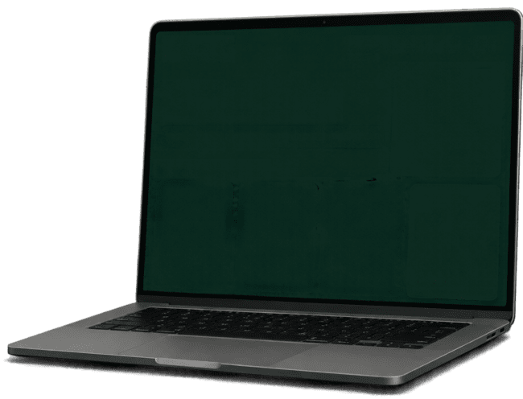

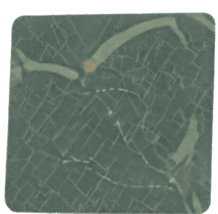











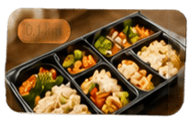

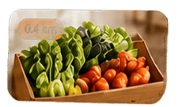
















A digital marketplace for
FoodBridge
Discover
Donations
Messages
Profile
Find food.
Reduce waste. Feed people.
food donations.
Search by food or location
Near me
Available donations near you
Donors post available surplus food
0.1 km
0.4 km
0.5 km
Recipients discover nearby donations
Prepared meals
Fresh vegetables
Bakery items
Make an impact
Food can be claimed quickly and efficiently
Community Kitchen
Fresh + Today
Green Market
Fresh + Today
Local Bakery
Fresh + Today
Share food. Support your community.
Claim
Claim
Claim
Communities collaborate to reduce hunger and waste

Slide 6
































How It Works
1
2
3
4
DONATE
DISCOVER
CLAIM
COLLECT & SHARE
provides list
surplus food.
Individuals or organizations browse available donations.
Recipients reserve suitable listings.
Recipients pick up and redirect food to those who need it.
LESS FOOD WASTE AND MORE COMMUNITY SUPPORT.

Slide 7




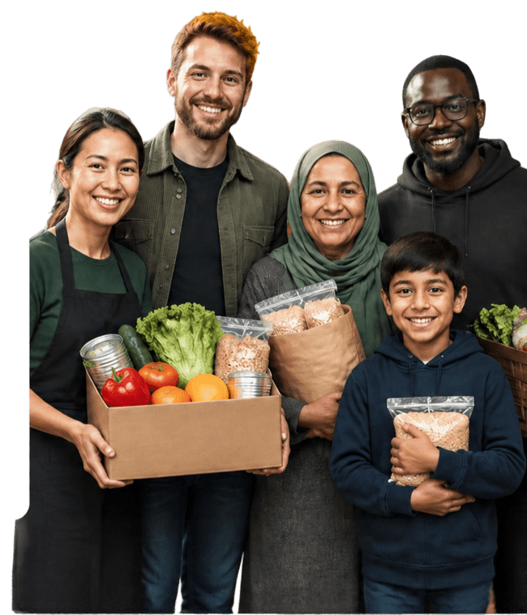






























Who
Benefits
Donors
Recipients
Communities
Reduce waste
Access food
support
Support
sustainability
Create positive
social impact
Find nearby
opportunities
Encourage
responsible
consumption
Simplify surplus
distribution
Receive food
quickly and
conveniently
Strengthen local
conventions

Slide 8

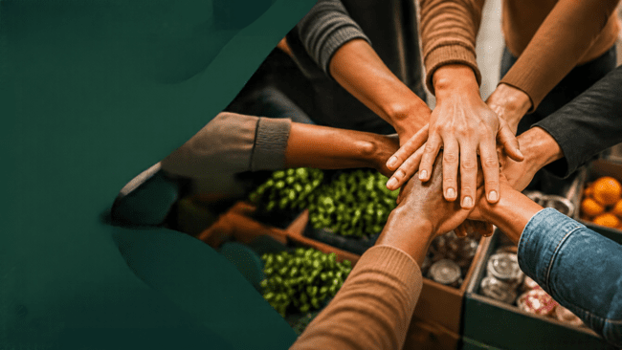
















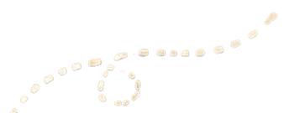

Join
FoodBridge
Donate surplus food.
Claim available food.
Build a more sustainable community.
foodbridge-six-jet.vercel.app

